Slide 1
Comparative genomics Bioinformatics Applications (PLPTH813)
Sanzhen Liu
4/11/2019

Slide 2
Outline
Introduction of comparative genomics
Structural variation
1. Copy number variation
2. Translocation and inversion
Homology
Approaches
1. Comparative genome hybridization
2. Paired-end reads
3. Read depth
3. Whole genome assembly

Slide 3
Comparative genomics among genomes
Conservation and variability
Homologs: Genomic regions derived from a common ancestral gene.
Orthologs: Homologs from the divergence of lineages.
Paralogs: Homologs derived from their duplication within a lineage.
Homeologs: The subset of paralogs created by WGD. (synonyms: ohnolog; syntenic paralog)

Slide 4
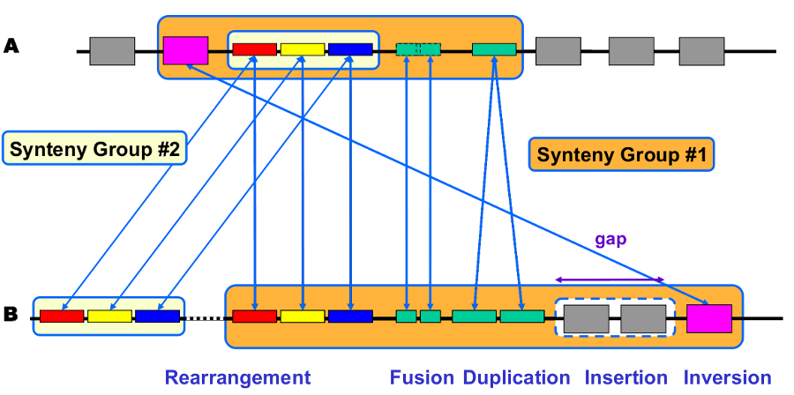
Synteny
Synteny is usually referred to as the conservation of blocks of order within two sets of chromosomes that are being compared with each other. Syntenic regions are evidence by homologous genes arranged in a collinear order.
genoscope.cns.fr

Slide 5
Intra-species genome rearrangements and structural variation (SV)
Variation of hundreds of bp to several Mb in size
Balanced variation
- Inversion
- Translocation
Unbalanced variation:
- Copy number variation (CNV)
(Presence/Absence variation, PAV)

Slide 6
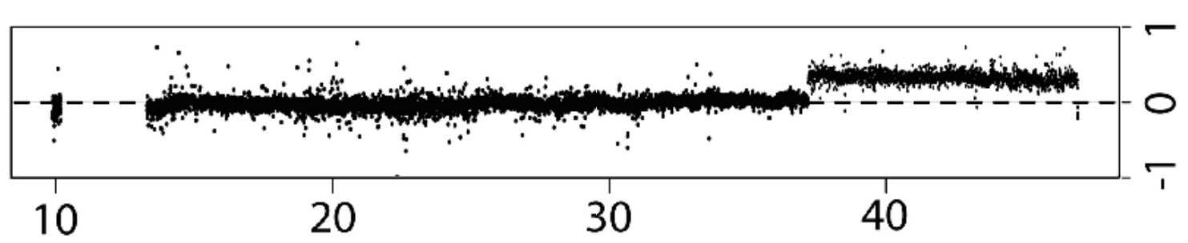
array Comparative Genomic Hybridization (aCGH)
A
+
B
array
Log2 (A/B)

Slide 7
NGS provides information for the discovery of variants, including structural variation

Slide 8
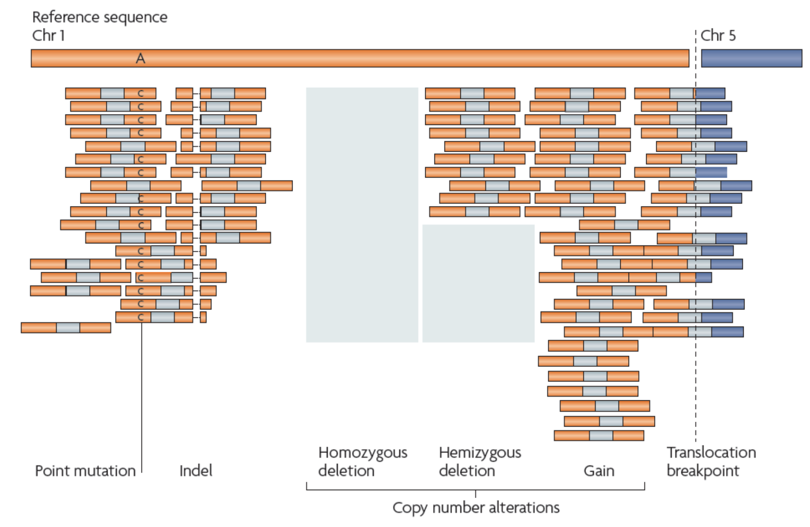
Variants in sequencing reads

Slide 9
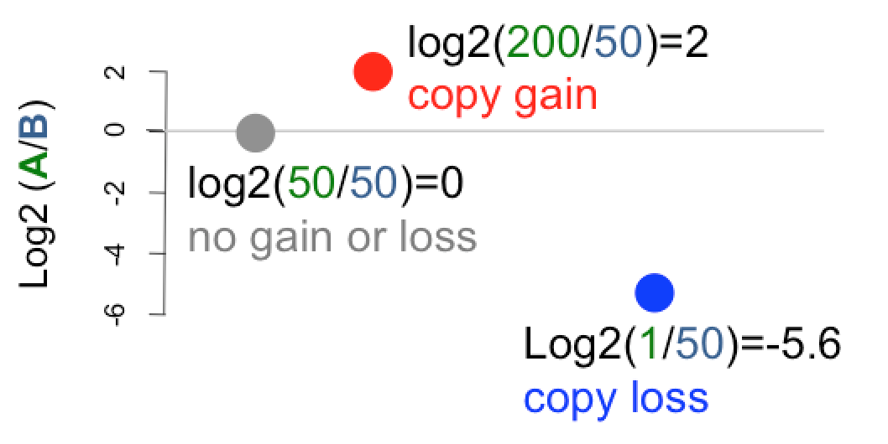
Read depths
Sequencing and Alignment
B
A

Slide 10
Paired-end reads to find "deletion" relative to the reference
......
800 bp
Reference genome
newly sequenced genome
Paired-end read
insertion size = 380 bp

Slide 11
Split reads to find "exact deletion sequence"
Reference genome
......
Reads
Deletion sequence

Slide 12
Paired-end reads to find "insertion" relative to the reference
210 bp
Reference genome
newly sequenced genome
Paired-end read
insertion
fragment size = 380 bp
The size of insertions that can be identified by PE reads is determined by fragment sizes and read lengths.

Slide 13
inversion
Reference genome
newly sequenced genome
split read
Reference genome
newly sequenced genome

Slide 14
Tandem duplication
Reference genome
newly sequenced genome

Slide 15
Translocation
Reference genome
chrA
chrB
newly sequenced genome

Slide 16
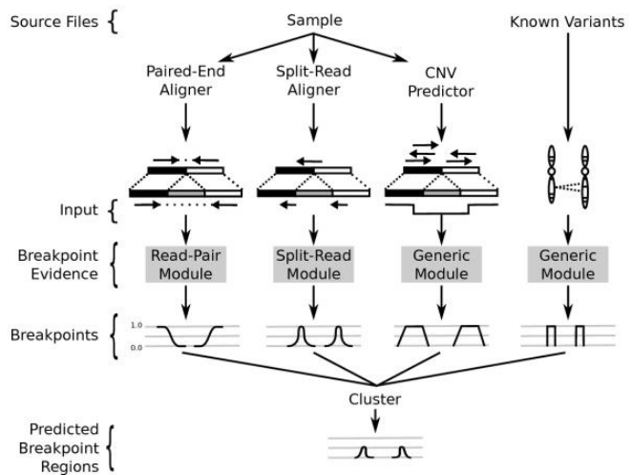
LUMPY: a integrative framework for SV discovery

Slide 17
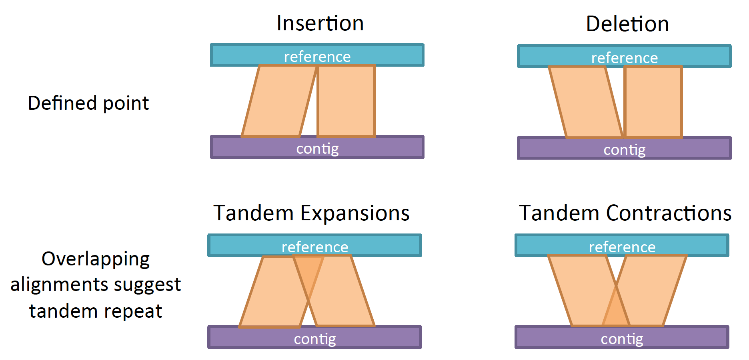
Genome assembly and genome-wide SV discovery

Slide 18
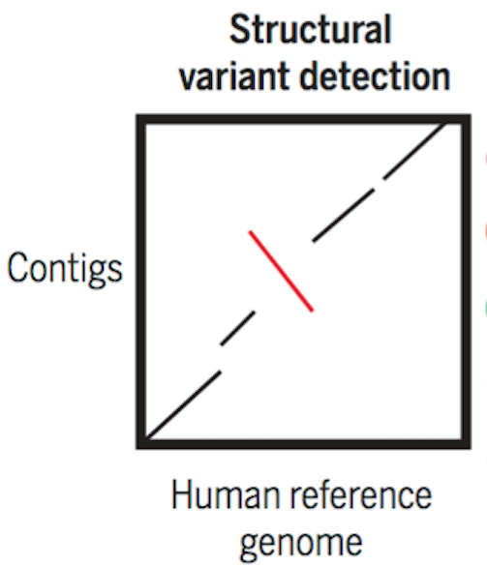
Genome assembly and macro-scale comparison

Slide 19
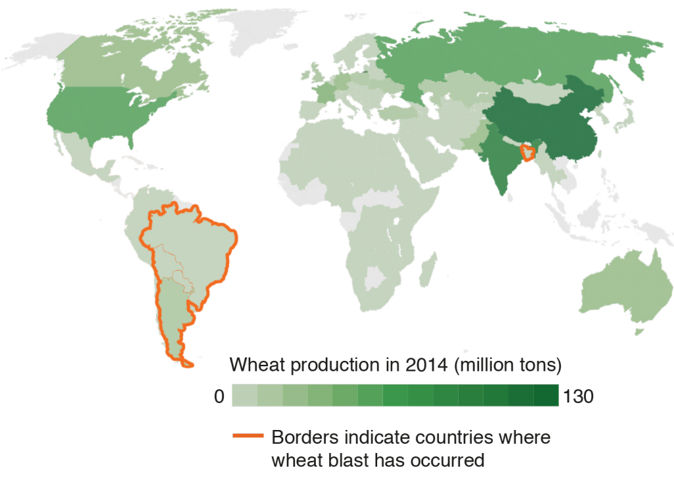
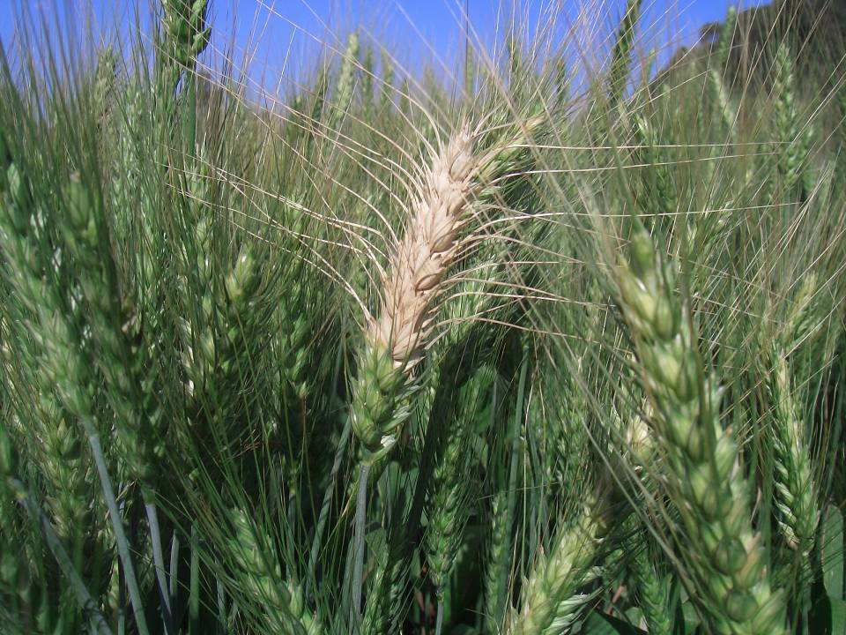
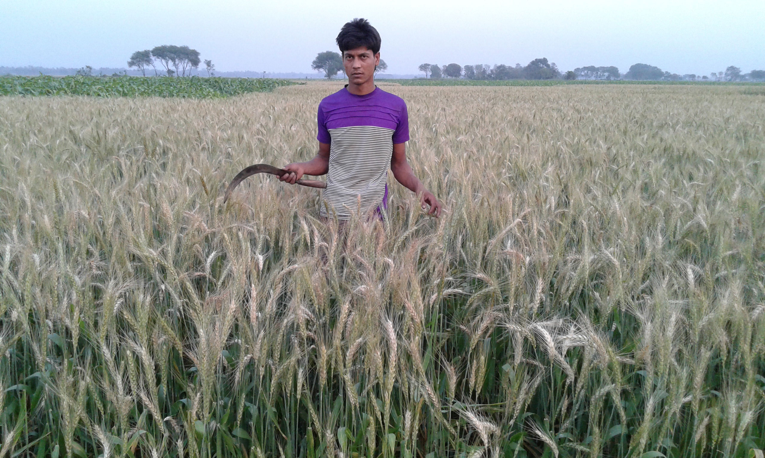
Wheat blast
Wheat blast identified in Brazil in 1985 ; spread to other countries in South America soon after that; jumped to Bangladesh in 2016.
Brazil, 2012
courtesy of Dr. Barbara Valent
Bangladesh, 2016
Photo by Paritosh Malaker
Bangladesh Agricultural Research Institute
CIMMYT
Wheat blast affected ~15% of total wheat area in Bangladesh

Slide 20
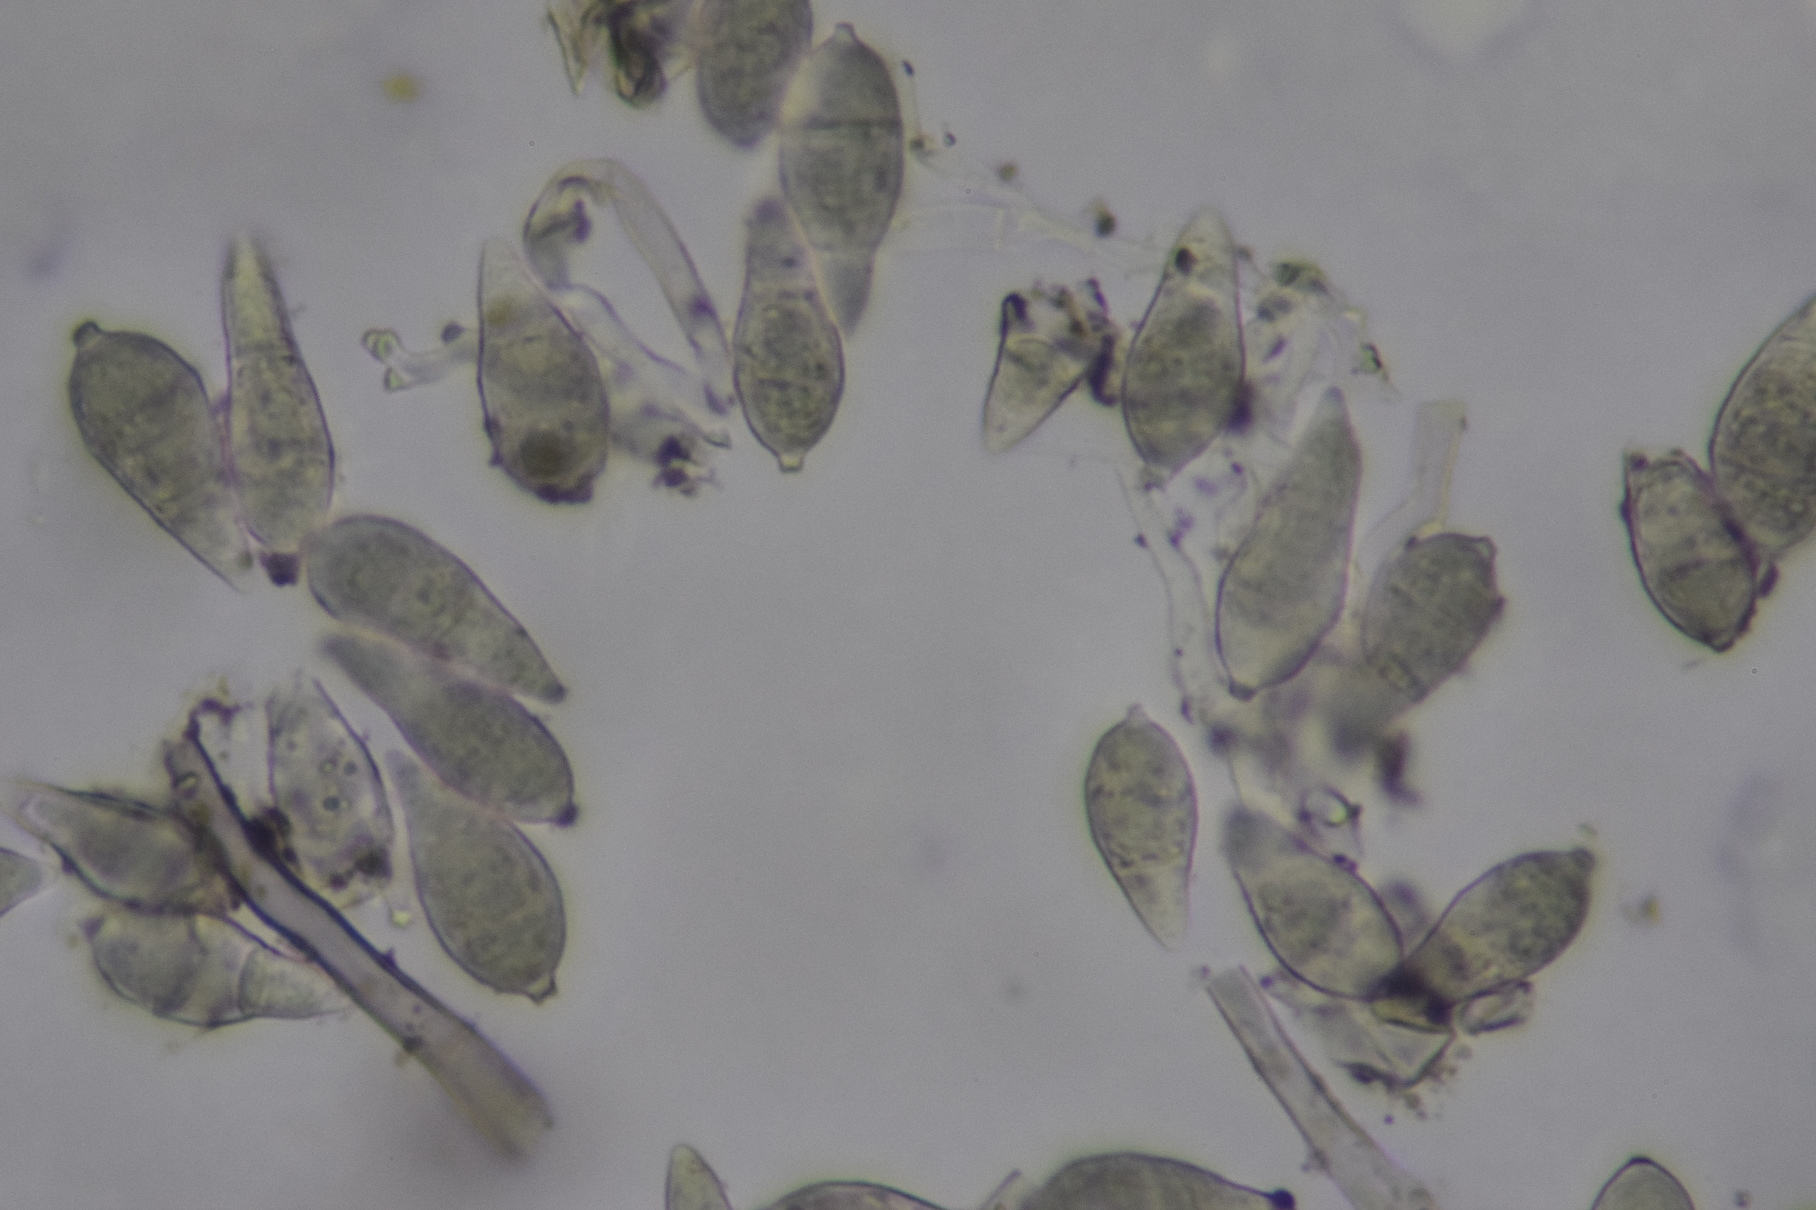
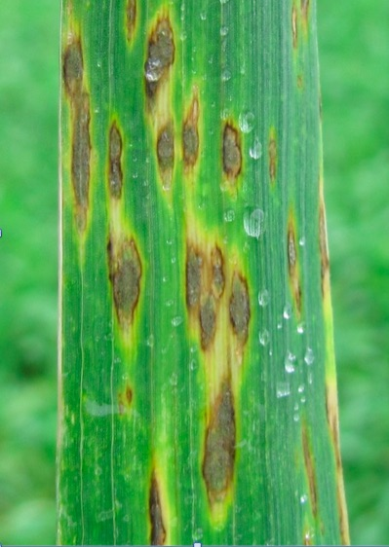
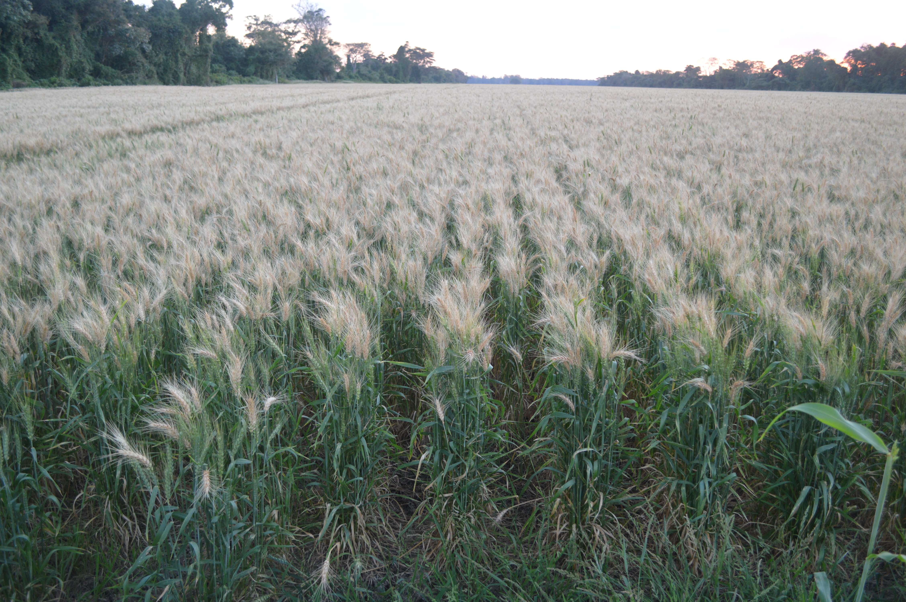
Wheat blast caused by the fungus Magnaporthe oryzae
M. oryzae
Warm rainy weather at heading results in 100% empty blasted heads.
courtesy of Dr. Barbara Valent

Slide 21
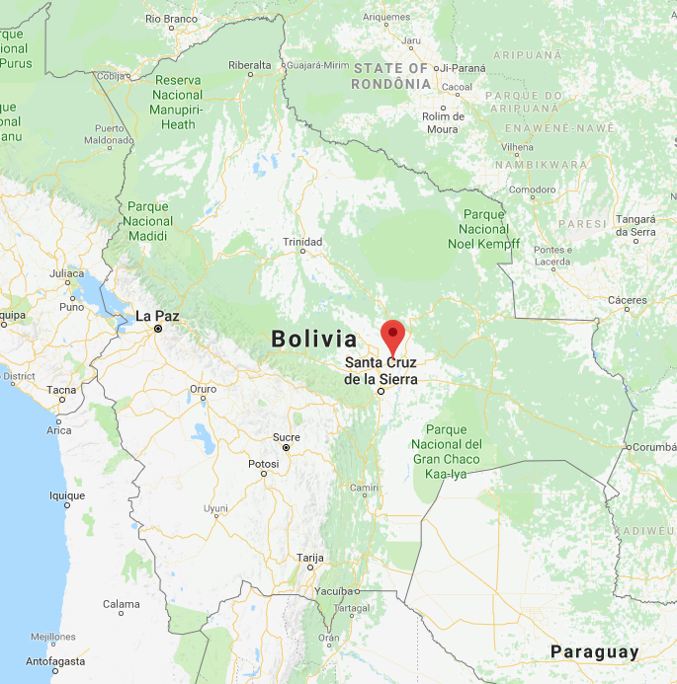
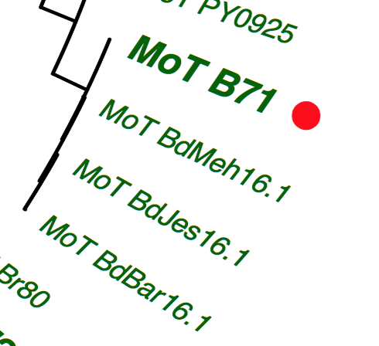
Select B71 to generate the reference genome
Strain | Year isolated | Isolation location
B71 | 2012 | Okinawa, Bolivia
B71 is an aggressive field isolate.
B71 is almost identical to isolates identified in Bangladesh 2016.
Bangladesh
isolates

Slide 22

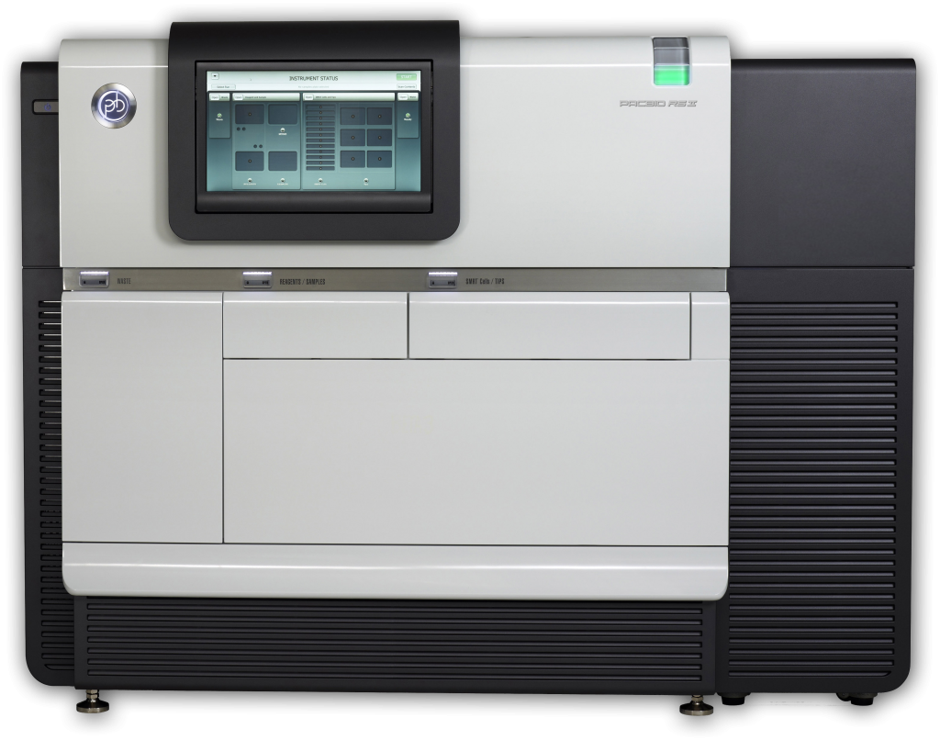
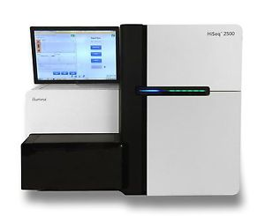
Genome sequencing for B71
K-State BRI
10 SMRTCell PacBio data (P6-C4)
Longest reads: 74,474 bp
Coverage*: 276x
PacBio RS II
PCR-free Illumina TruSeq data
>2x10⁷ pairs of 2x250 paired-end reads
Coverage*: 222x
HiSeq 2500
* assuming the genome size is 45 Mb

Slide 23
Summary of the assembly
List of contigs (N=31)
Contig | Length (bp) | GC%
tig00000000 | 7,902,655 | 51.2
tig00000024 | 7,531,155 | 49.1
tig00000030 | 6,090,985 | 50.2
tig00000003 | 5,402,116 | 51.2
tig00000011 | 4,657,194 | 49.2
tig00000004 | 4,442,877 | 51.2
tig00000005 | 4,042,640 | 49.2
tig00000001 | 1,778,515 | 46.4
tig00000014 | 461,599 | 49.4
tig00000025 | 398,015 | 44.3
tig00000039 | 253,502 | 45.1
tig00000026 | 240,676 | 43.8
tig00000018 | 237,459 | 47.4
tig00000016 | 184,678 | 48
tig00000007 | 138,010 | 49.9
tig00000022 | 110,918 | 46
tig00000020 | 78,737 | 49.6
tig00000006 | 69,533 | 51.1
tig00000033 | 69,131 | 49.2
tig00000043 | 57,199 | 28.4
tig00000015 | 51,862 | 48.5
tig00000008 | 47,134 | 47.6
tig00000031 | 42,261 | 48.6
tig00000041 | 36,641 | 52.5
tig00000023 | 36,455 | 44.2
tig00000037 | 35,037 | 48.9
tig00000032 | 32,608 | 49.7
tig00000017 | 28,099 | 51.7
tig00000038 | 27,162 | 49.5
tig00000019 | 25,161 | 51.2
tig00000027 | 12,906 | 47.3
Statistics of the assembly*
Item | Statistics
total contig number | 31
total contig length | 44,522,920
longest contig | 7,902,655
shortest contig | 12,906
N50 | 5,402,116
overall GC | 0.50
min contig GC | 0.28
* Canu for PacBio assembly
Quiver polishing
Further error correction using Illumina data
# mitochondial sequence

Slide 24
BAC-end sequencing for assembly improvement?
+ insert
long genomic DNA fragment (e.g., 200 kb)
Vector
scaffolding
Vector
contig 1
contig 2
BAC
Sequence BAC ends of clones one by one, which is very low-throughput and cost-inefficient.

Slide 25
Idea: build random barcodes in vectors to enable a high throughput (I)
code (Red)
Vector with barcode (Red)
BAC
Sequences with barcode
Notes:
no needs to do single clone manipulation

Slide 26
Idea: build random barcodes in vectors to enable a high throughput (II)
Paired ends based on barcodes
millions of barcoded vectors in a pool
High-throughput
end sequencing
tens of thousands of clones
Notes:
no needs to do single clone manipulation

Slide 27

LIEP Scaffolding to improve the B71 assembly
LIEP scaffolding
Long Distance End Pairs (LIEP)
contig 1
contig 2
scaffolding two contigs to a sequence
~95% are long-distance read pairs

Slide 28
MoT B71 final assembly vs. MG8 (70-15, rice strain)
Chr | Length (bp)
chr1 | 6,442,091
chr2 | 7,902,655
chr3 | 8,206,304
chr4 | 5,402,116
chr5 | 4,442,877
chr6 | 6,090,985
chr7 | 4,042,640
scaf1 | 941,816
scaf2 | 739,928
scaf3 | 104,670
scaf4 | 74,396
scaf5 | 69,131
Wheat
blast fungal strain
rice blast fungal reference
>10 kb overlap and >95% identity
Notes:
the two genomes are largely co-linear except for a few rearrangements, insertions, inversions.

Slide 29
Illumina sequencing of additional eight strains
Name | Year isolated | Host species | Isolation location
T25 | 1988 | Triticum | Paraná, Brazil
Py5020 | 2005 | Triticum | Paraná, Brazil
Py22.1 | 2007 | Triticum | Paraná, Brazil
B2 | 2011 | Triticum | Quirusillas, Bolivia
B71 | 2012 | Triticum | Okinawa, Bolivia
P3 | 2012 | Triticum | Canindeyú,Paraguay
P28 | 2014 | Bromus | Paraguay
P29 | 2014 | Bromus | Paraguay
B51 | 2012 | Eleusine | Quirusillas, Bolivia

Slide 30
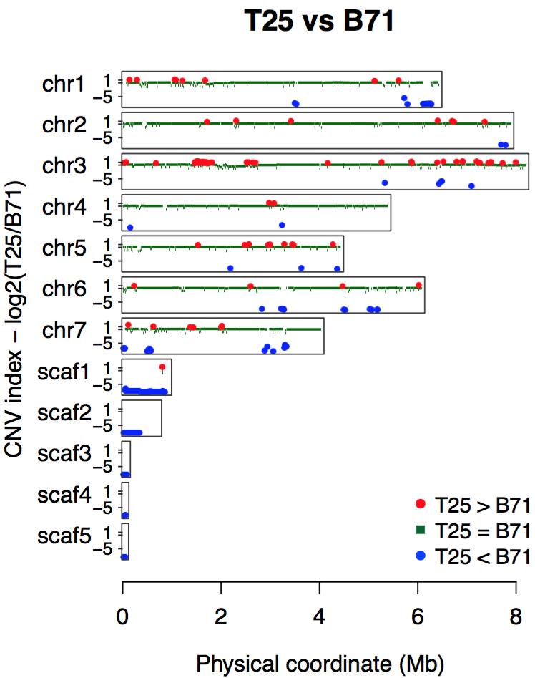
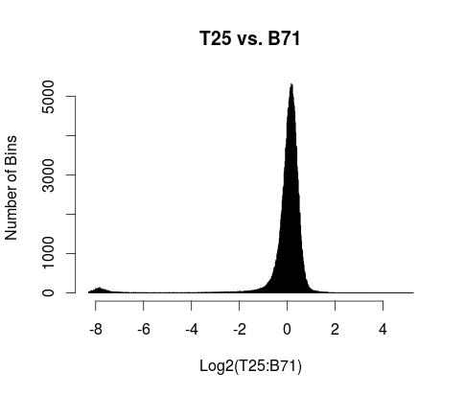
Read depths to infer copy number variation
Aligned reads to the reference genome
Divided genome divided to bins
Determined counts of uniquely mapped reads per bin
Compared read depths in T25 vs B71
Simply consider:
red: two copies in T25
green: conserved
blue: no copies in T25
Merged neighboring bins with similar signals into segments

Slide 31
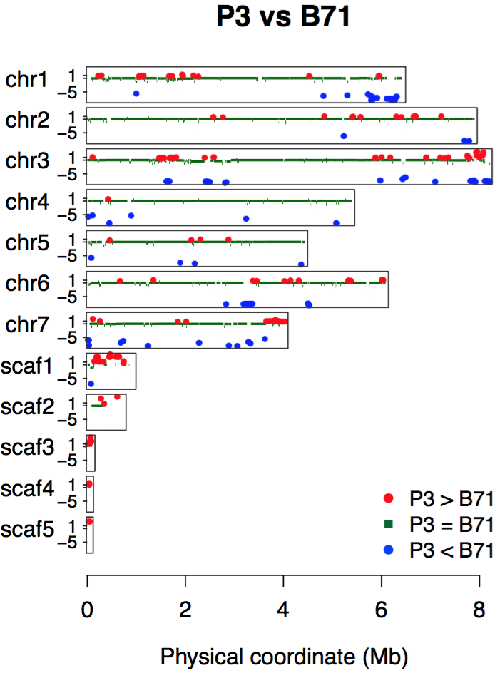
P3 vs. B71
Scaf1-5
Highly dynamic
Highly repetitive
Not anchored to chr1-7
of a rice strain (dispensable)
Dispensable
mini-chromosome?
extra chromosome; supernumerary chromosome

Slide 32
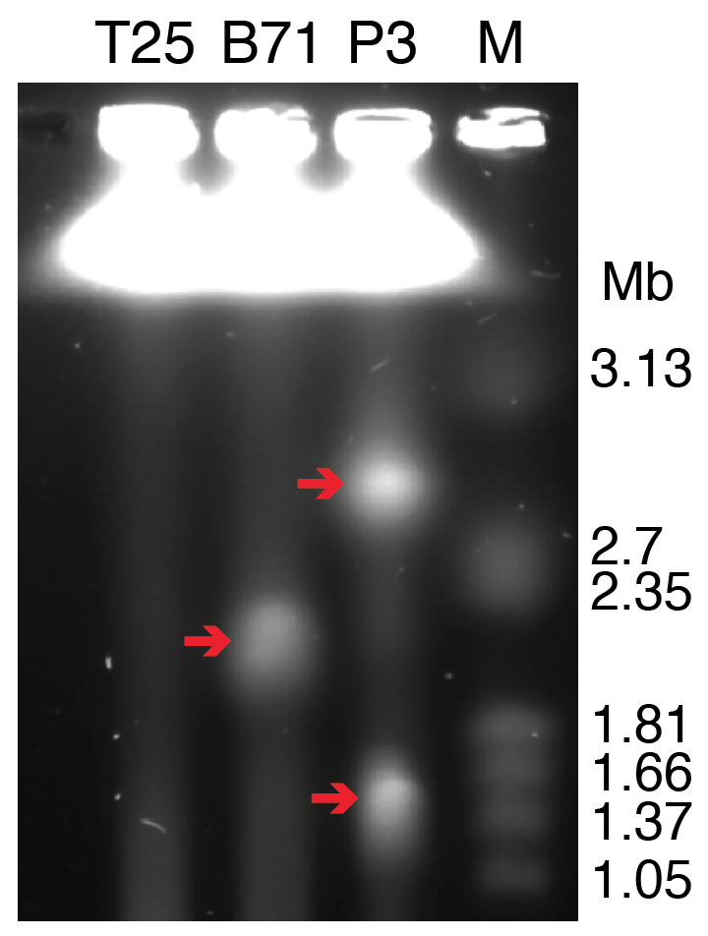
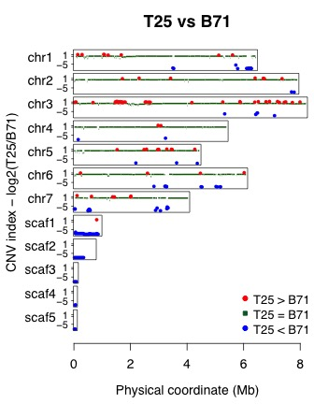
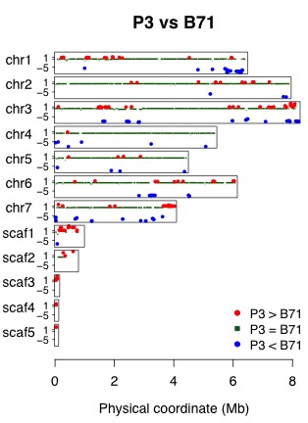
CHEF gel to separate chromosome-sized DNA
Are some of the scaf1-5 or all from the mini-chromosome?
T25 has no mini-chromosomes
B71 has one and P3 has two
Notes:
the CNV results of scaffolds 1-5 match the mini-chromosome pattern

Slide 33
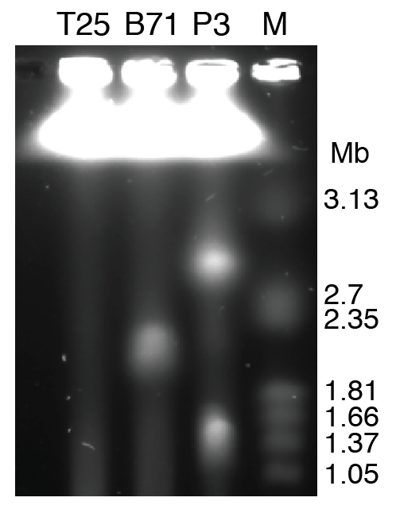
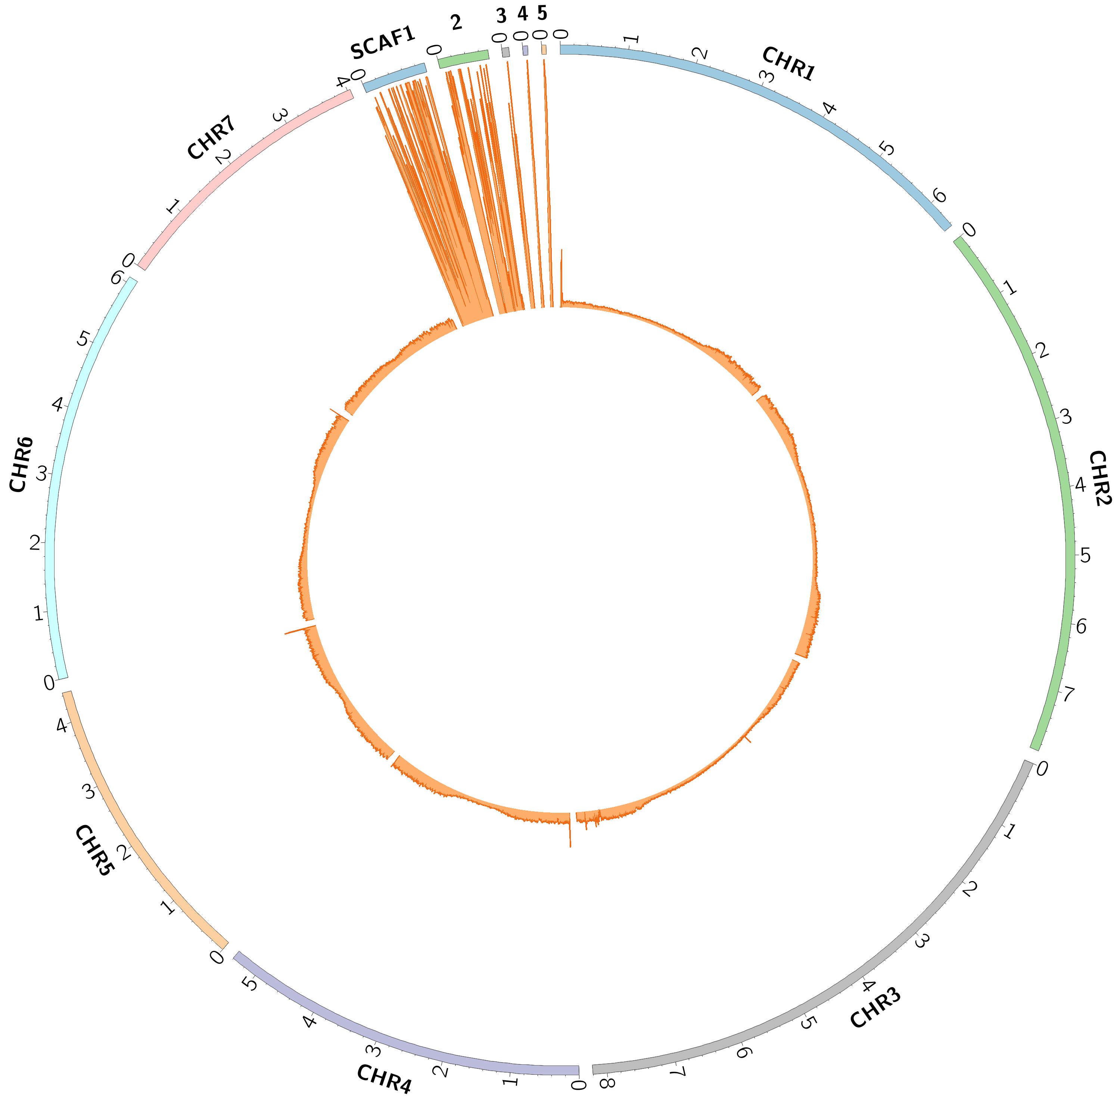
Illumina sequencing of mini-chromosomes (mini) recovered from CHEF gels
B71mini
DNA recovered from gels
Whole mini sequencing
Alignment to the B71 genome
Genomic coverage and depth of uniquely mapped reads
All five scaffolds (scaf1-5) are from the mini.

Slide 34
References
Pinkel, D. & Albertson, D. G. Comparative genomic hybridization. Annu. Rev. Genomics Hum. Genet. 6, 331–354 (2005).
Miller, W., Makova, K. D., Nekrutenko, A. & Hardison, R. C. Comparative genomics. Annu. Rev. Genomics Hum. Genet. 5, 15–56 (2004).
Korbel, J. O. et al. Paired-end mapping reveals extensive structural variation in the human genome. Science 318, 420–426 (2007).
Armstrong, J., Fiddes, I. T., Diekhans, M. & Paten, B. Whole-Genome Alignment and Comparative Annotation. Annu Rev Anim Biosci (2018). doi:10.1146/annurev-animal-020518-115005
Kronenberg, Z. N. et al. High-resolution comparative analysis of great ape genomes. Science 360, (2018).

